Slide 1
Lecture 7c Solving Recurrence Relations 3

Slide 2
Five Methods
2
Guess + Prove by Induction
Telescoping a Sum
Substituting
Solving homogeneous/inhomogeneous recurrence relations
Master Method
only the order obtained, not the precise formula (technically not solution)

Slide 3
Recall: Solving Homogeneous Recurrence Relations
a_{o}t_{n}+a₁t_{n-1}+…+a_{k}t_{n-k} = 0
+ k initial conditions, usually 0≤i≤k-1 or 1≤i≤k
Write characteristic polynomial
p(x) = a₀x^{k}+a₁x^{k-1}+…+a_{k-2}x²+a_{k-1}x+a_{k}
Find roots of characteristic polynomial r₁,…, r_{k}
General form of solution t_{n} = c₁r₁^{n}+c₂r₂^{n}+…+c_{k}r_{k}^{n}
Find all c_{i} from n initial conditions
3

Slide 4
Solving Inhomogeneous Recurrence Relations
a_{o}t_{n}+a₁t_{n-1}+…+a_{k}t_{n-k} = b^{n}q(n)
q(n) is a polynomial in n of degree d
Write characteristic polynomial
p(x) = (a₀x^{k}+a₁x^{k-1}+…+a_{k-2}x²+a_{k-1}x+a_{k})(x-b)^{d+1}
The only difference

Slide 5
Solving Inhomogeneous Recurrence Relations
a_{o}t_{n}+a₁t_{n-1}+…+a_{k}t_{n-k} = b^{n}q(n)
q(n) is a polynomial in n of degree d
Write characteristic polynomial
p(x) = (a₀x^{k}+a₁x^{k-1}+…+a_{k-2}x²+a_{k-1}x+a_{k})(x-b)^{d+1}
(n+5)3^{n} d=1 b=3
3^{n} (=1*3^{n}) d=0 b=3
n (=n*1^{n}) d=1 b=1
1 (=1*1^{n}) d=0 b=1
5

Slide 6
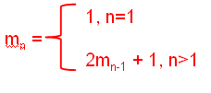
Solving Inhomogeneous Recurrence Relations
a_{o}t_{n}+a₁t_{n-1}+…+a_{k}t_{n-k} = b^{n}q(n)
q(n) is a polynomial in n of degree d
Write characteristic polynomial
p(x) = (a₀x^{k}+a₁x^{k-1}+…+a_{k-2}x²+a_{k-1}x+a_{k})(x-b)^{d+1}
^{Example: Hanoi}
1
6

Slide 7
Example: Hanoi

Slide 8
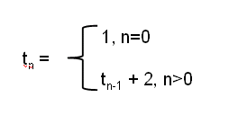
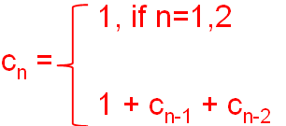
Solving Inhomogeneous Recurrence Relations
^{Example: Factorial operations}
^{Fibonacci recursive program}
2
Function calls
3
8

Slide 9

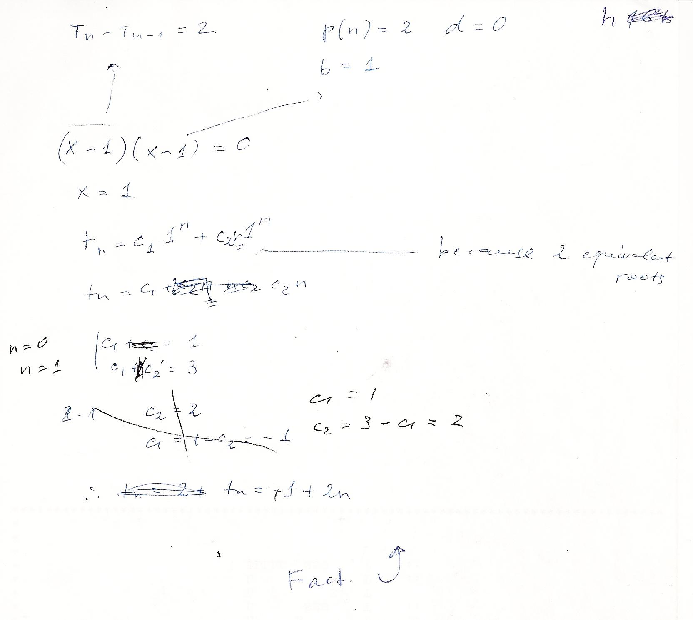
Factorial time
9

Slide 10
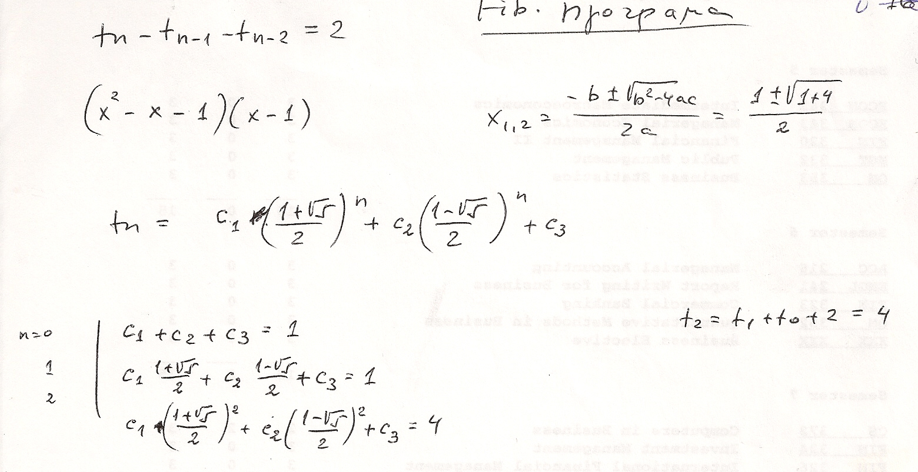
Fibonacci program
t_{n} = O(φ^{n}) = O((5/3)^{n})
No need to find constants if we only want to determine the order
10

